Slide 1
Functions

Slide 2
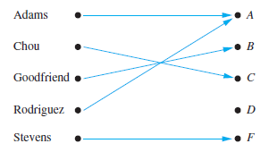
Introduction
In many instances we assign to each element of a set a particular element of a second set.
For example, suppose that each student in a discrete mathematics class is assigned a letter grade from the set {A,B,C,D, F}.
And suppose that the grades are A for Adams, C for Chou, B for Goodfriend, A for Rodriguez, and F for Stevens.
This assignment is an example of a function.

Slide 3
Definition
Let A and B be nonempty sets. A function f from A to B is an assignment of exactly one element of B to each element of A. We write f (a) = b if b is the unique element of B assigned by the function f to the element a of A. If f is a function from A to B, we write f : A → B.
Functions are sometimes also called mappings or transformations.
Functions are specified in many different ways. Sometimes we explicitly state the assignments, as in Figure previous slide.
Often we give a formula, such as f (x) = x + 1, to define a function.

Slide 4
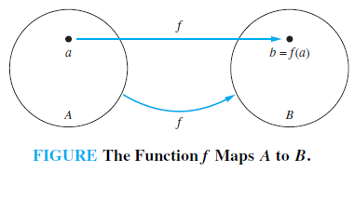
Definition
If f is a function from A to B, we say that A is the domain of f and B is the codomain of f. If f (a) = b, we say that b is the image of a and a is a preimage of b. The range, or image, of f is the set of all images of elements of A. Also, if f is a function from A to B, we say that f maps A to B.

Slide 5
Example
What are the domain, codomain, and range of the function that assigns grades to students described in the first paragraph of the introduction of this section?
“Suppose that each student in a discrete mathematics class is assigned a letter grade from the set {A,B,C,D, F}. And suppose that the grades are A
for Adams, C for Chou, B for Goodfriend, A for Rodriguez, and F for Stevens.”
Solution
Let G be the function that assigns a grade to a student in our discrete mathematics class. Note that G(Adams) = A, for instance. The domain of G is the set {Adams, Chou, Goodfriend, Rodriguez, Stevens}, and the codomain is the set {A,B,C,D, F}. The range of G is the set {A,B,C, F}, because each grade except D is assigned to some student.

Slide 6
Example
Let R be the relation with ordered pairs (Abdul, 22), (Brenda, 24), (Carla, 21), (Desire, 22), (Eddie, 24), and (Felicia, 22). Here each pair consists of a graduate student and this student’s age. Specify a function determined by this relation.
Solution
If f is a function specified by R, then f (Abdul ) = 22, f (Brenda) = 24, f (Carla) = 21, f (Desire) = 22, f (Eddie) = 24, and f (Felicia) = 22. (Here, f (x) is the age of x, where x is a student.)
For the domain, we take the set {Abdul, Brenda, Carla, Desire, Eddie, Felicia}. We also need to specify a codomain, which needs to contain all possible ages of students.
Because it is highly likely that all students are less than 100 years old, we can take the set of positive integers less than 100 as the codomain. The range of the function we have specified is the set of different ages of these students, which is the set {21, 22, 24}.

Slide 7
Example
Let f be the function that assigns the last two bits of a bit string of length 2 or greater to that string. For example, f (11010) = 10. Then, the domain of f is the set of all bit strings of length 2 or greater, and both the codomain and range are the set {00, 01, 10, 11}.
Example
Let f : Z → Z assign the square of an integer to this integer. Then, f (x) = x², where the domain of f is the set of all integers, the codomain of f is the set of all integers, and the range of f is the set of all integers that are perfect squares, namely, {0, 1, 4, 9, . . . }.

Slide 8
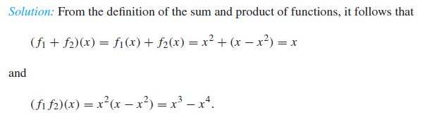
Definition
Let f₁ and f₂ be functions from A to R. Then f₁ + f₂ and f₁f₂ are also functions from A to R defined for all x ∈ A by (f₁ + f₂)(x) = f₁(x) + f₂(x), (f₁f₂)(x) = f₁(x)f₂(x).
Example
Let f₁ and f₂ be functions from R to R such that f₁(x) = x² and f₂(x) = x − x². What are the functions f₁ + f₂ and f₁f₂?

Slide 9
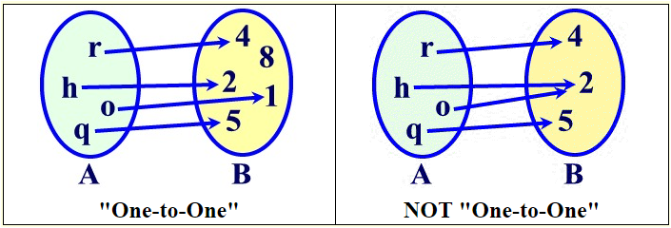
One-to-one function
Some functions never assign the same value to two different domain elements. These functions are said to be one-to-one.
A function f is said to be one-to-one, or an injunction, if and only if f (a) = f (b) implies that a = b for all a and b in the domain of f. A function is said to be injective if it is one-to-one. No element of B is the image of more than one element in A.

Slide 10
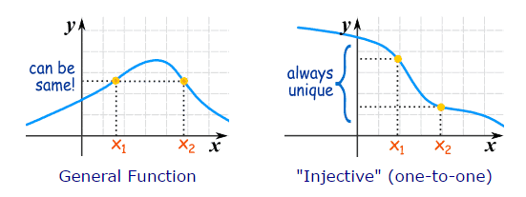
One-to-one function-Continue
We never get the same "y" value twice.

Slide 11
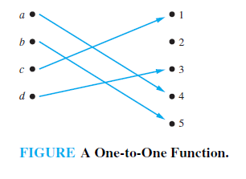
Example
Determine whether the function f from {a, b, c, d} to {1, 2, 3, 4, 5} with f (a) = 4, f (b) = 5, f (c) = 1, and f (d) = 3 is one-to-one.
Solution
The function f is one-to-one because f takes on different values at the four elements of its domain.
Example
Determine whether the function f (x) = x² from the set of integers to the set of integers is one-to-one.

Slide 12
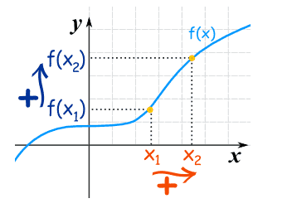
Increasing function
A function is "increasing" when the y-value increases as the x value increases, like this
The function is Increasing but it is not strictly Increasing (no flatness allowed)

Slide 13

Continue
For a function y=f(x):

Slide 14
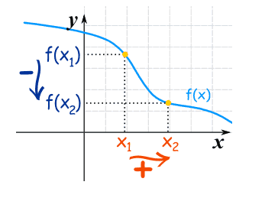

Decreasing function
The y-value decreases as the x-value increases:
For a function y=f(x):

Slide 15
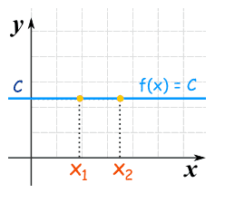
Constant function
A Constant Function is a horizontal line:

Slide 16
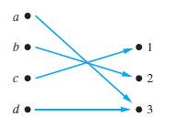
Onto function
A function f from A to B is called onto, or a surjection, if and only if for every element b ∈ B there is an element a ∈ A with f (a) = b. A function f is called surjective if it is onto.
Example
Let f be the function from {a, b, c, d} to {1, 2, 3} defined by f (a) = 3, f (b) = 2, f (c) = 1, and f (d) = 3. Is f an onto function?
Solution
Because all three elements of the codomain are images of elements in the domain, we see that f is onto. Note that if the codomain were {1, 2, 3, 4},
then f would not be onto.

Slide 17
Example
Is the function f (x) = x² from the set of integers to the set of integers onto?
Solution
The function f is not onto because there is no integer x with x² = −1, for instance.
Example
Is the function f (x) = x + 1 from the set of integers to the set of integers onto?
Solution
This function is onto, because for every integer y there is an integer x such that f (x) = y.

Slide 18
One-to-one correspondence
The function f is a one-to-one correspondence, or a bijection, if it is both one-to-one and onto. We also say that such a function is bijective.
Example
Let f be the function from {a, b, c, d} to {1, 2, 3, 4} with f (a) = 4, f (b) = 2, f (c) = 1, and f (d) = 3. Is f a bijection?
Solution
The function f is one-to-one and onto. It is one-to-one because no two values in the domain are assigned the same function value. It is onto because all four elements of the codomain are images of elements in the domain. Hence, f is a bijection.

Slide 19
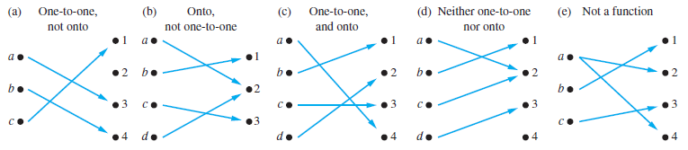
Examples of Different Types of Correspondences
The first is one-to-one but not onto, the second is onto but not one-to-one, the third is both one-to-one and onto, and the fourth is neither one-to-one nor onto. The fifth correspondence in Figure is not a function, because it sends an element to two different elements.

Slide 20
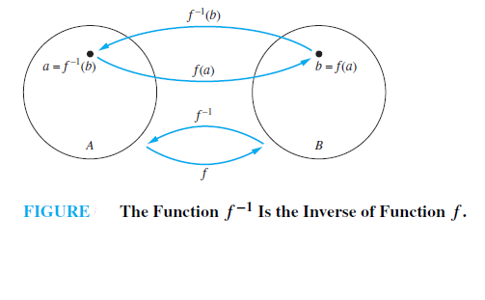
Inverse Function
Let f be a one-to-one correspondence from the set A to the set B. The inverse function of f is the function that assigns to an element b belonging to B the unique element a in A such that f (a) = b. The inverse function of f is denoted by f ⁻¹. Hence, f ⁻¹(b) = a when f (a) = b.

Slide 21
Example
Let f be the function from {a, b, c} to {1, 2, 3} such that f (a) = 2, f (b) = 3, and f (c) = 1. Is f invertible, and if it is, what is its inverse?
Function
The function f is invertible because it is a one-to-one correspondence. The inverse function f ⁻¹ reverses the correspondence given by f , so f ⁻¹(1) = c, f ⁻¹(2) = a, and f ⁻¹(3) = b.

Slide 22
Example
Let f be the function from R to R with f (x) = x². Is f invertible?
Solution
Because f (−2) = f (2) = 4, f is not one-to-one. If an inverse function were defined, it would have to assign two elements to 4. Hence, f is not invertible.

Slide 23
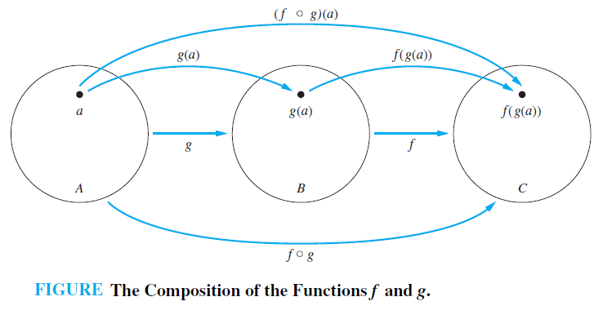
Definition
Let g be a function from the set A to the set B and let f be a function from the set B to the set C. The composition of the functions f and g, denoted for all a ∈ A by f ◦ g, is defined by (f ◦ g)(a) = f (g(a)).

Slide 24
Example
Let f and g be the functions from the set of integers to the set of integers defined by f (x) = 2x + 3 and g(x) = 3x + 2. What is the composition of f and g? What is the composition of g and f ?
Solution
Both the compositions f ◦ g and g ◦ f are defined.
(f ◦ g)(x) = f (g(x)) = f (3x + 2) = 2(3x + 2) + 3 = 6x + 7
and
(g ◦ f )(x) = g(f (x)) = g(2x + 3) = 3(2x + 3) + 2 = 6x + 11.

